Slide 1

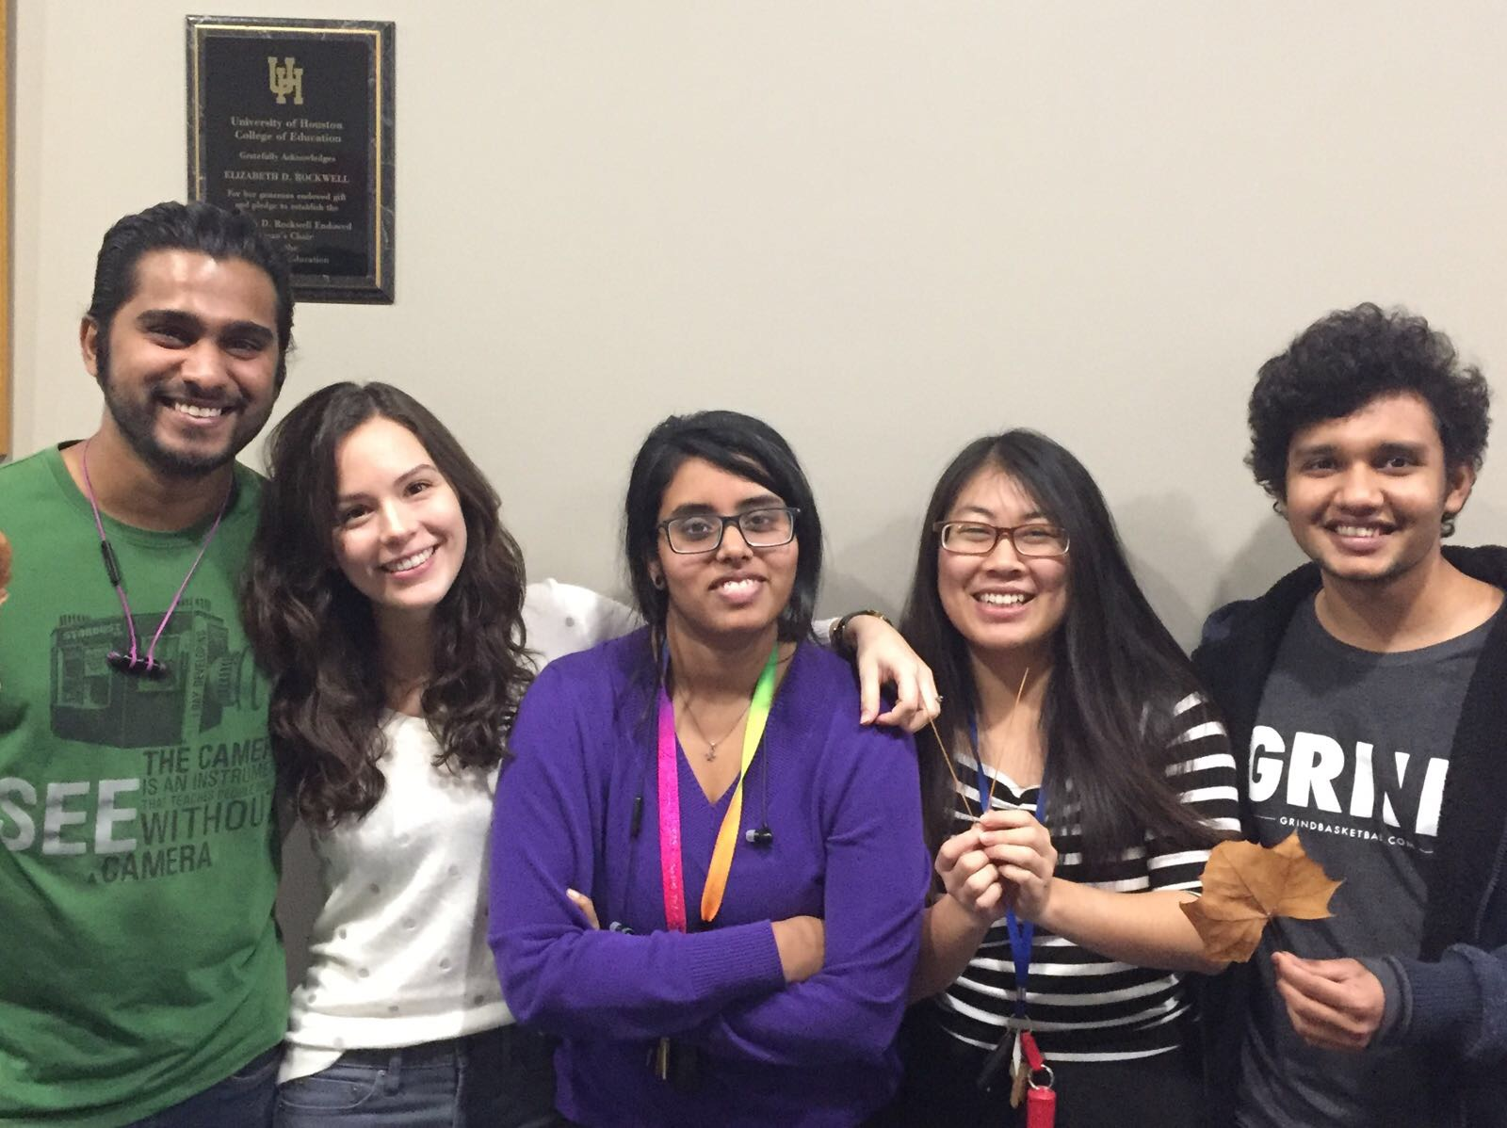
University of Houston
ECE 6397- Selected Topics
Synthetic Leaf generation using Conditional Adversarial Networks and classification with CNN
Gaurav Roy, Rachel Mills, Aditi Singh, Xiaoyang Li，Raj Shah

Slide 2
Introduction and Motivation
Traditional tree classification
GAN
Prior work
Generate more samples
Classification
Prior Work
Nearest Neighbors
Notes:
Rachel
Intro:
Trees are traditionally classified using manuals and field guides, this is time consuming. Many species become extinct quickly so there is a need for a better classifier.
There have been previous attempts to address this problem.
Gan previously used to in increase sample size, but no attempts to test and see how well their generated images fit the original model
In this project, we use GAN to see how well our classifier performs
Prior leaf classification has been done using nearest neighbours. There is an application to classify leaves that utilises nearest neighbours, however, its reviews are not that good.
T

Slide 3
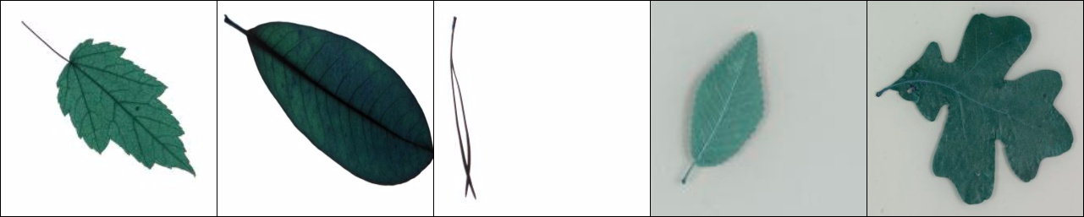
Description of Dataset
Five tree types with select species
4,923 samples
Maple, Magnolia, Pine, Elm, Oak leaves (left to right)
Genus | Number of Samples
Elm | 932
Magnolia | 880
Maple | 995
Oak | 1,040
Pine | 1,076
Notes:
Rachel
Number of samples per genus limited because of limited number of samples per species, some genera had more species than others.

Slide 4
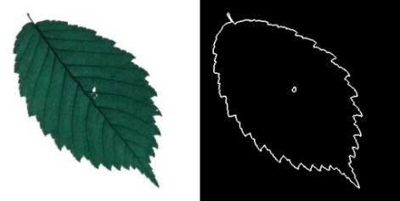
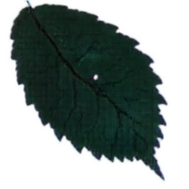
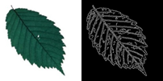

Border
GAN
reconstruction
Synthetic Image
Data preprocessing
Testing
Maple
Oak
Elm
Magnolia
Pine
Original Image
of leaf
Training
CNN Classifier
(Supervised)
Data preprocessing
Testing
GAN
reconstruction
Synthetic Image
Vein
Notes:
Rachel

Slide 5
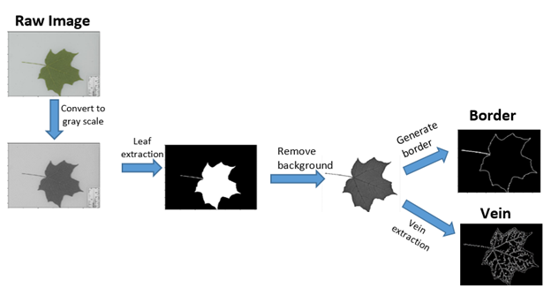

Preprocessing
GAN Input
Image size = 512 *256
Figure. Flow chart of preprocessing to create GAN inputs
Notes:
Rachel - stop 2:00
To generate the hand-written leaves, we consider two common forms to simulate sketch images: border and vein. Border images only outline the shape of leaves while vein images delineate the exact fracture of leaves. The procedure of preprocessing is as follows:
1) Decolorize the raw image from RGB to gray image
2) Implement global thresholding on the gray image to generate the leaf mask
3) Cast the mask on gray scales image and remove the background
4) A. Generate the border of leave
B. Apply a canny filter to extract the vein

Slide 6
Border
GAN
reconstruction
Synthetic Image
Data preprocessing
Testing
Maple
Oak
Elm
Magnolia
Pine
Original Image
of leaf
Training
CNN Classifier
(Supervised)
Data preprocessing
Testing
GAN
reconstruction
Synthetic Image
Vein

Slide 7
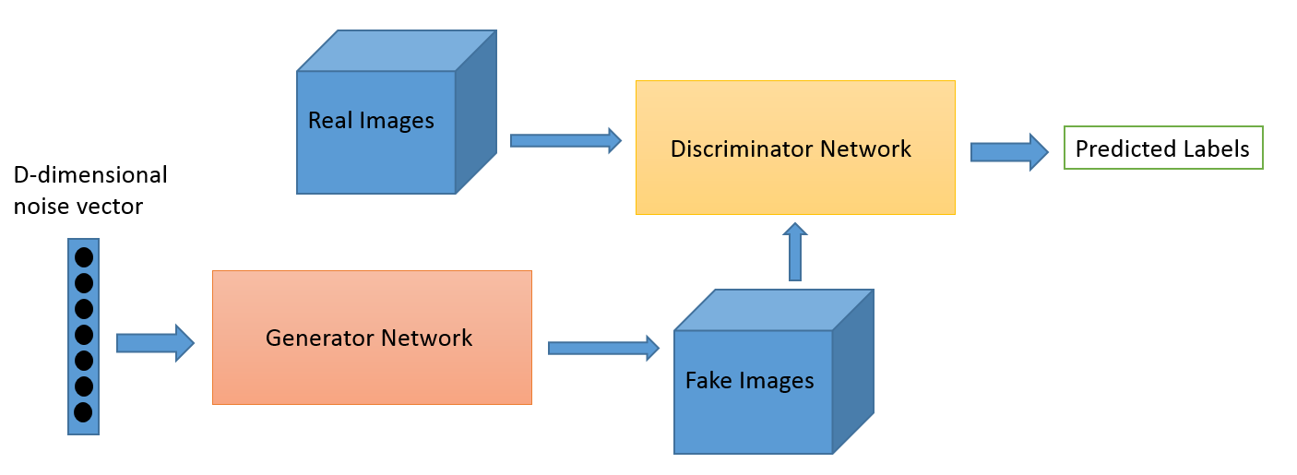
Generative Adversarial Network (GAN)
GAN has two neural networks which compete against each other
Generator network G(z)
Discriminator network D(x)

Slide 8
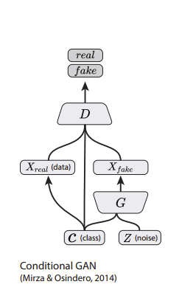


Conditional GAN (cGAN)
These are a conditional version of GANs.
The generator uses input along with noise.
Notes:
GANs: conditioned only on D
CGANs: conditioned on both D and G
If we don’t condition it produces deterministic output

Slide 9
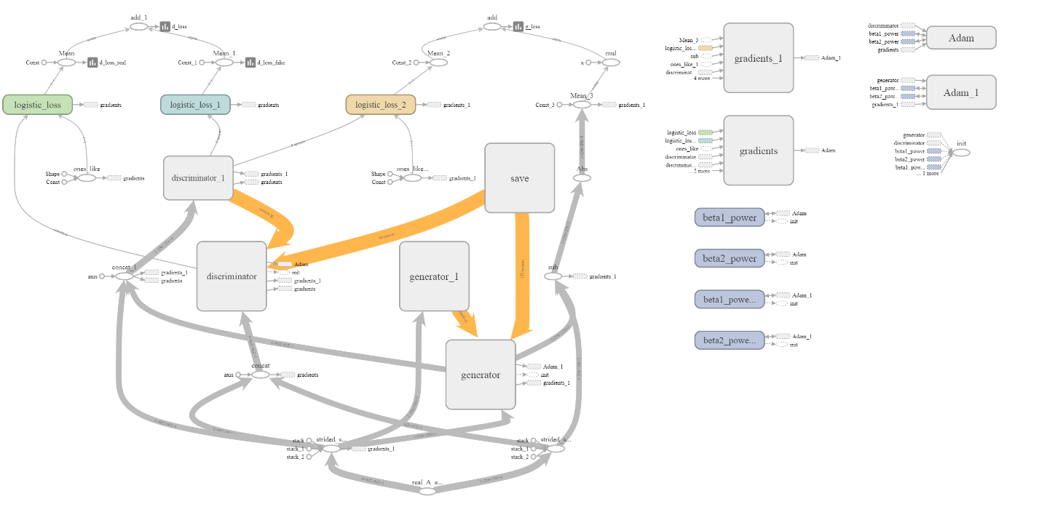
Architecture graph of cGAN
Isola, Phillip, et al. "Image-to-image translation with conditional adversarial networks." arXiv preprint arXiv:1611.07004 (2016).
Figure. Graph of cGAN architecture (generated from Tensorboard)

Slide 10
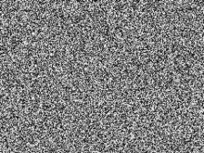
Implementation of cGAN :
---- image to image translation
border
noise
Learn the translator of
“border to leaf”
Generator of
border to leaf
Fake leaf
leaf
Discriminator of
real leaf to fake leaf
vein
noise
Generator of
vein to leaf
Learn the translator of
“vein to leaf”
Fake leaf
leaf
Discriminator of
real leaf to fake leaf
Notes:
The conditional GAN could also be regarded as the a image to image translation architecture. We implement this architecture to learn 2 image translators independently: one for “border to leaf”, another for vein to leaf. Take example of frame one, generator or “translator” is set to create a Fake leaf image from the given image of border and noise. After learning finished, the generator will be able to “fool” the discriminator to tell the difference between real leaf image and fake leaf image

Slide 11
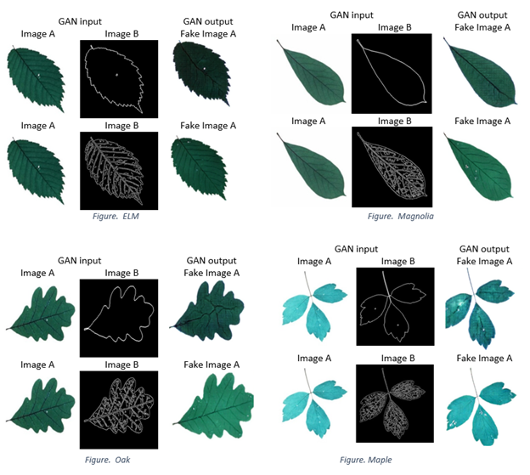
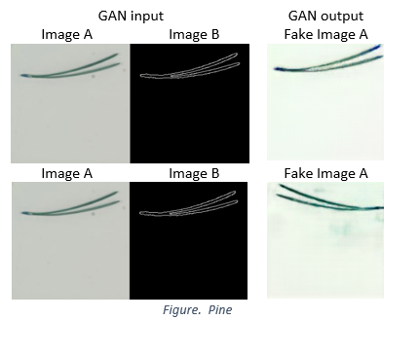
Testing Results
Apply the translator of
“border to leaf”
and
“vein to leaf”
Notes:
We can see that the fake images reconstructed from vein look more similar to the real leaf since it delineate the most of the texture detail of leafs, however the border reconstructed one have some distortion of the texture.

Slide 12
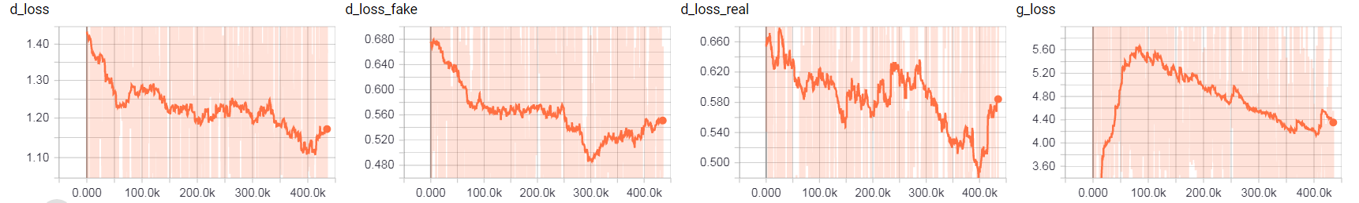
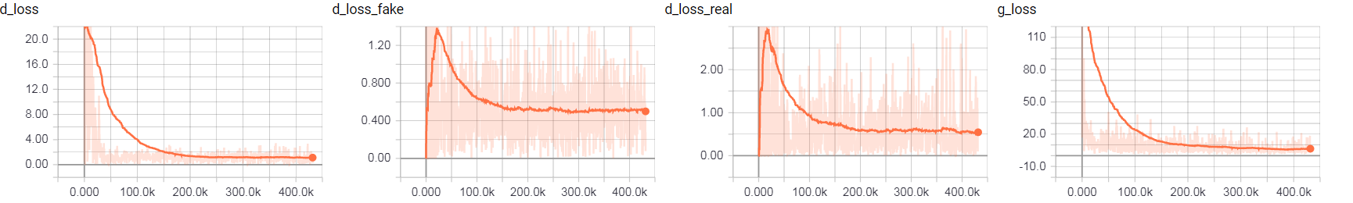
Checkpoints of Training
Runs for 87 epoch, 500K steps, 4 days.
Learning rate = 1e-3
d_loss = d_loss_fake + d_loss_real
Reconstruct from vein
Reconstruct from border
Notes:
Vein
D_loss = D_loss_fake + D_loss_real. D_loss has reduced by 22%
Border
D_loss is defined as the cross entropy of the binary classification discriminator(fake-0,real1)
G_loss is defined as the min max of Generator object functions
Here we see d_loss initially is low as compared to g_loss, which is true as initially generator has random noise and discriminator would easily be able to distinguish between real and fake. After 500k steps, both the d_loss and g_loss goes to zero, which means generator can now fool the discriminator by creating images like that from the dataset.

Slide 13
Border
GAN
reconstruction
Synthetic Image
Data preprocessing
Testing
Maple
Oak
Elm
Magnolia
Pine
Original Image
of leaf
Training
CNN Classifier
(Supervised)
Data preprocessing
Testing
GAN
reconstruction
Synthetic Image
Vein

Slide 14
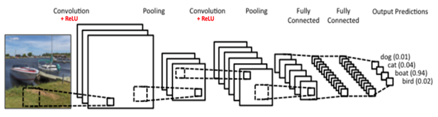
Convolutional Neural Networks
Convolution
Rectifier Linear Unit (ReLu)
Max Pooling
Fully Connected Network

Slide 15
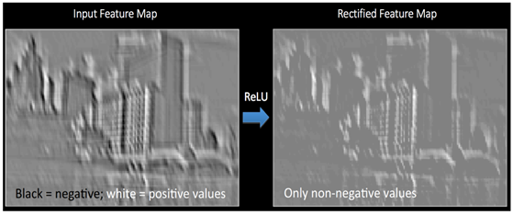
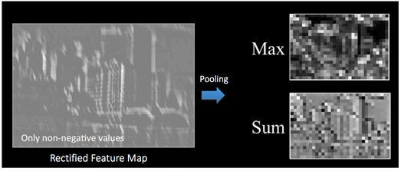
ReLu and Max Pooling

Slide 16
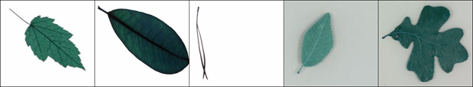
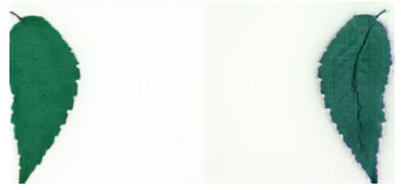
Dataset used in CNN
Trained on Original Images
Tested on reconstructed Images (output of GAN)

Slide 17
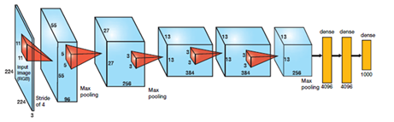
Classification using CNN
Alexnet as classifier
Trained on original data
Testing on reconstructions of border and vein images
Notes:
To understand the reconstruction quality

Slide 18
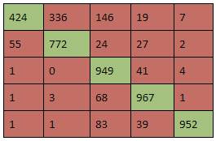
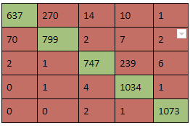
Classification using CNN
Performance:
Number of Training Images | Training Accuracy | Validation Accuracy | Testing Accuracy
 |  |  | Border | Vein
4923 | 92.85% | 96.85% | 87.14% | 82.55%
Accuracy
Vein based GAN reconstruction confusion matrix Border based GAN reconstruction confusion matrix
Notes:
Sketches alone can’t classify

Slide 19
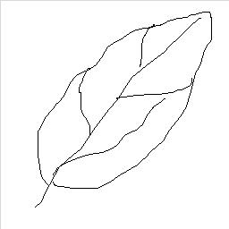
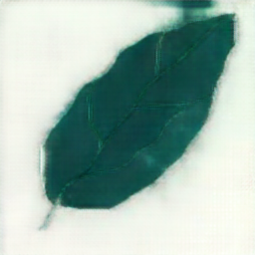
Maple
Oak
Elm
Magnolia
Pine
Original Image
of leaf
Training
CNN Classifier
(Supervised)
Testing
GAN
reconstruction
Synthetic Image
Hand-
drawn vein

Slide 20
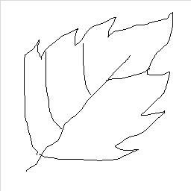
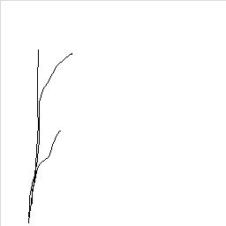
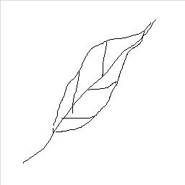
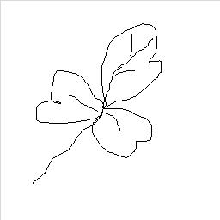
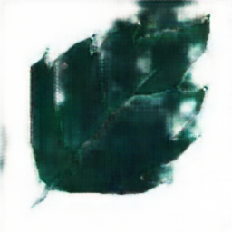
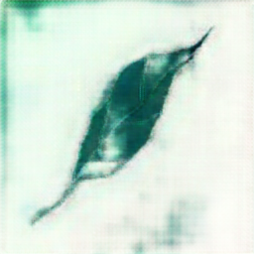
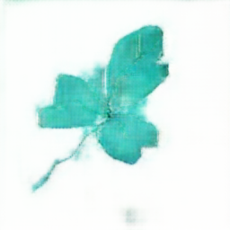
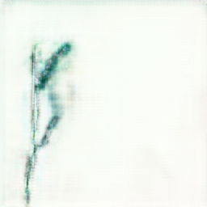
Reconstructed hand-drawn images using cGAN
Maple
Magnolia
Pine
Elm
Oak
Oak(99%) Magnolia(95%) Pine(99%) Maple(93%) Maple(99%)
Notes:
Classification not good for hand-drawn reconstructions

Slide 21
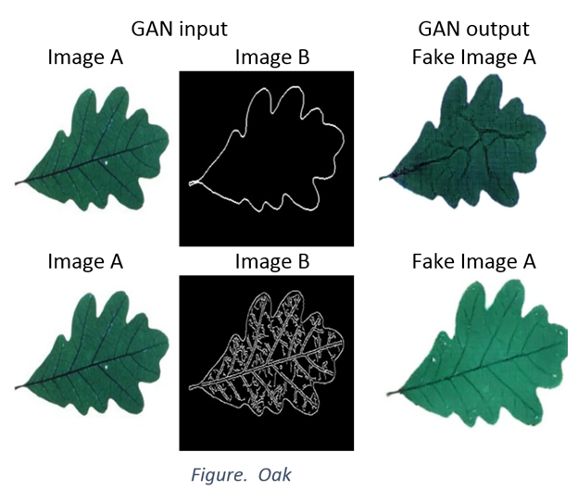
Discussion
Although fake images generated from borders have worse visually reconstructed results than images generated from vein, they have a better classification accuracy result.
Border
87.14%
Vein
82.55%
=> Vein only helps reconstruct the image but bring noise to classifier
Vein feature as an instance of local texture pattern is not a significant feature for leaf order classification
Notes:
The classifier is not look at the vein, but only the borders, Which is similar to our human vision that when we are trying to classify an object, we look more about the image as a whole rather than textures in detail.

Slide 22
Future Work
Add more species of leaves to detect more classes
Generalize a quantification tool to describe border vs vein outcomes
Improve the classification accuracy by applying different weights to veins and borders
Extend the architecture to check the significance of any “broad sense feature” to the image classification problem
Notes:
Add other elements to classify trees, Apply method to other elements, such as animal species or human faces . Quantification tool, other than classification. Use this kind of study to find which broad sense feature is important is image classification

Slide 23
References
Agarwal, S., Roth, D.: Learning a sparse representation for object detection. In: Proc. European Conf. Comp. Vision. Volume LNCS 2353., Copenhagen, Denmark (2002) 113–127
Fei-Fei, L., Fergus, R., Perona, P.: Learning generative visual models from few training examples: an incremental Bayesian approach tested on 101 object categories. In: Proc. IEEE Conf. Comp. Vision Patt. Recog Workshop on GenerativeModel Based Vision. (2004)
Fergus, R., Perona, P., Zisserman, A.: Object class recognition by unsupervised scale-invariant learning. In: Proc. IEEE Conf. Comp. Vision Patt. Recog. Vol. II (2003) 264–271
Isola, Phillip and Zhu, Jun-Yan and Zhou, Tinghui and Efros, Alexei A, “Image-to-Image Translation with Conditional Adversarial Networks”
Ji-Xiang Du, Xiao-Feng Wang, Guo-Jun Zhang, Leaf shape based plant species recognition, In Applied Mathematics and Computation, Volume 185, Issue 2, 2007, Pages 883-893, ISSN 0096-3003, https://doi.org/10.1016/j.amc.2006.07.072.
Krizhevsky, Alex, Ilya Sutskever, and Geoffrey E. Hinton. "Imagenet classification with deep convolutional neural networks." Advances in neural information processing systems. 2012
Neeraj Kumar, Peter N. Belhumeur, Arijit Biswas, David W. Jacobs, W. John Kress, Ida Lopez, João V. B. Soares, "Leafsnap: A Computer Vision System for Automatic Plant Species”
Ponce J. et al. (2006) Dataset Issues in Object Recognition. In: Ponce J., Hebert M., Schmid C., Zisserman A. (eds) Toward Category-Level Object Recognition. Lecture Notes in Computer Science, vol 4170. Springer, Berlin, Heidelberg
Shanwen Zhang, Yingke Lei, Tianbao Dong, Xiao-Ping Zhang, Label propagation based supervised locality projection analysis for plant leaf classification, In Pattern Recognition, Volume 46, Issue 7, 2013, Pages 1891-1897, ISSN 0031-3203, https://doi.org/10.1016/j.patcog.2013.01.015.
Scott Reed, Zeynep Akata, Xinchen Yan, Lajanugen Logeswaran, Bernt Schiele, Honglak Lee: Generative Adversarial Text to Image Synthesis
Wiseodd. “Wiseodd/Generative-Models.” GitHub, 28 Oct. 2017, github.com/wiseodd/generative-models.
Yenchenlin. “Yenchenlin/pix2pix-Tensorflow.” GitHub, 22 Mar. 2017, github.com/yenchenlin/pix2pix-tensorflow.

Slide 24
Task distribution
Group Member | Contributions
Rachel Mills | Literature review, dataset assembly, report compilation
Raj Shah | GAN model study, GAN result analysis, report compilation
Xiaoyang Li | Image preprocessing, GAN code review, GAN implementation
Gaurav Roy | CNN model study, CNN result analysis, report compilation
Aditi Singh | GAN code review, CNN implementation, Interactive Interface building

